Slide 1

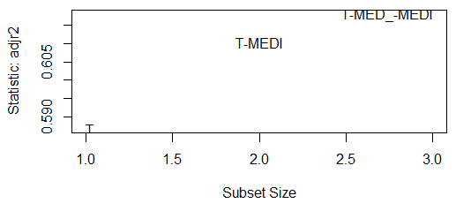
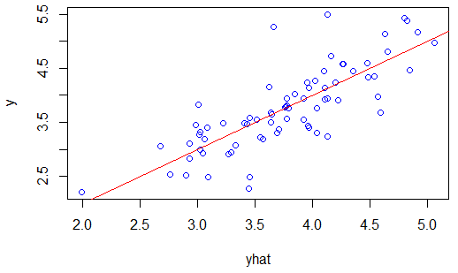
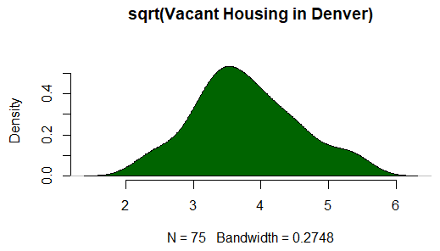
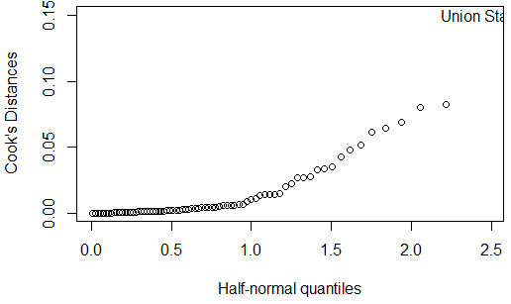
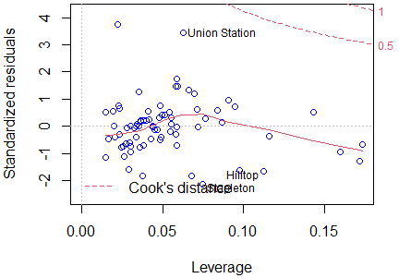
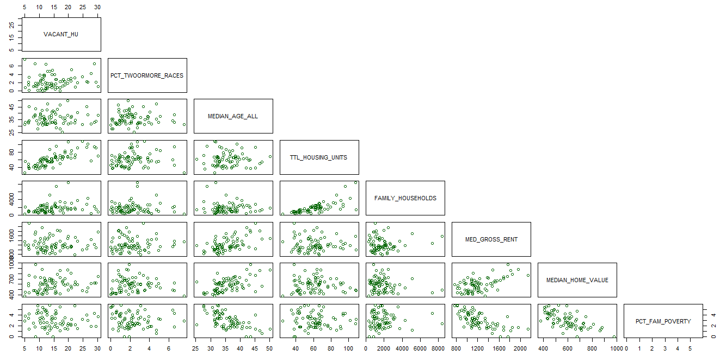


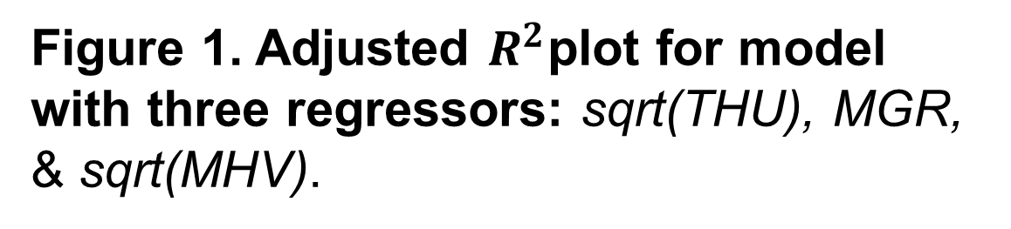



Housing Availability in Denver Neighborhoods
^{Adelle Price}
Applied Linear Regression D2P Project, Department of Mathematical and Statistical Sciences, University of Colorado Denver
MOTIVATION
LINEAR REGRESSION MODEL
Denver, CO can be identified as a “High-Opportunity City” with high median income and high job growth. However, Denver, CO is also facing low numbers of single family permitting housing. ¹
The number of new home listings in Denver, CO has been reported to decrease 11.5% from 2020 to 2021. ²
Median home buying costs in Denver, CO have been reported to rise 12.6% from 2020 to 2021.³
$$\hat{{\left(Vacant Housing\right)}^{\frac{1}{2}}}=−4.054+0.251{\left(THU\right)}^{\frac{1}{2}}−0.003MGR+0.011{\left(MHV\right)}^{\frac{1}{2}}$$
Standard Linear Regression Fitted Model
$$\hat{Y}= {\hat{β}}_{0}+{\hat{β}}_{1}X_{1}+ {\hat{β}}_{2}X_{2}+…+{\hat{β}}_{p−1}X_{p−1}$$
$$\hat{Vacant Housing}=Estimated Amount of Vacant Housing$$
$$THU=Total Housing Units$$
$$MGR=Median Gross Rent$$
MHV = Median Home Value
$$\hat{Y} =Estimated Mean Response$$
$$X_{i}=Observed Values of each Regressor$$
$${\hat{β}}_{0}=Model Intercept$$
${\hat{β}}_{i}=Estimated Cofficients for Regressors X_{p−1}$
METHODS
MODEL SELECTION
EXPLORATORY DATA ANALYSIS
American Community Survey Nbrhd (2013-2017)
Neighborhoods within the City and County of Denver
5 year average
78 sampled neighborhoods
146 observations per neighborhood
Figure 1. Adjusted $R^{2}$plot for model with three regressors: sqrt(THU), MGR, & sqrt(MHV).
Figure 2. Plot of observed response values vs. estimated response values.
FIGURE 1. Density plot of the sqrt transformation of vacant housing in Denver neighborhoods.
Table 1. Numerical summaries of each observation investigated.
 | Min. | Median | Max.
sqrt(Vacant Houses) | 4.899 | 13.528 | 30.166
sqrt(Percent of Individuals of Two or more Races) | 0.000 | 1.924 | 7.563
Median Age | 25.30 | 35.10 | 50.10
sqrt(Total Housing Units) | 24.98 | 60.11 | 108.23
Number of Family Households | 308.0 | 1511.0 | 8403.0
Median Gross Rent | 772 | 1160 | 2143
sqrt(Median Home Value) | 378.9 | 590.9 | 978.5
sqrt(Percent of Families in Poverty) | 0.00 | 2.91 | 5.76
Observations Investigated
Number of vacant houses
Percent of two or more races
Median age per neighborhood
Total housing units
Number of family households
Median gross rent
Median home value
Percent of families in poverty
FIGURE 3. Index plot of Cook’s distances in the model.
FIGURE 4. Residuals vs. Leverage Points + Cook’s distance thresholds.
FIGURE 2. Scatterplot matrix showing pairwise correlation of all observations investigated.
Observation titles to the right of each graph denote y-axis labels; Observation titles in the column of the graph denote x-axis labels.
Applied Linear Regression
Neighborhoods with missing values excluded, 76 neighborhoods analyzed
Statistical Methods Include:
Akaike Information Criterion (AIC); considers fit of model and parameters used to determine model with lowest prediction error
R-squared; goodness of fit measure
Cook’s distance; distances above .5 suggest an influential leverage point
Table 1. Summary of selected model.
Table 2. 95% Confidence Intervals for the estimated regression coefficients.
 | Estimate | Std Error | t value | P value
Intercept | -4.054 | 2.737 | -1.481 | 0.143
sqrt(THU) | 0.251 | 0.025 | 10.204 | 1.462e-15
MGR | -0.003 | 0.002 | -1.385 | 0.170
sqrt(MHV) | 0.011 | 0.004 | 2.662 | 0.010
 | Estimate | 2.5% | 97.5%
Intercept | -4.054 | -9.510 | 1.403
sqrt(THU) | 0.251 | 0.202 | 0.300
MGR | -0.003 | -0.006 | 0.001
sqrt(MHV) | 0.011 | 0.003 | 0.020
n | Residual SE | R-Squared
75 | 3.827 | 0.61
POLICY RECOMMENDATIONS
REFERENCES
Per our fitted model, an increase in total housing units corresponds to an increase in vacant housing, an increase in median gross rent corresponds to a decrease in vacant housing(although this is not observed to be significant), and an increase in median home value corresponds to an increase in vacant housing.
Policy recommendations involve increasing the availability of affordable housing. Denver’s Community Planning and Development committee has proposed an “Expanding Housing Affordability” plan that looks to “allow projects to build taller buildings if more affordable units are included, update the city’s linkage fee, which requires all new development to either include affordable housing or pay a fee that supports Denver’s affordable housing fund, and change to state law on "inclusionary housing," which refers to requirements that cities can establish for new for-sale or for-rent developments.” ⁴
1. A Comprehensive Look at Housing Market Conditions Across America's Cities, Cityscape , 2020, Vol. 22, No. 2, Two Essays on Unequal Growth in Housing (2020), pp. 111-132.
2. Metro Denver housing market selling homes faster and faster, https://www.denverpost.com/2021/03/03/denver-housing-market-high-costs-low-inventory/
3. Latest Denver-area housing market stats: Median single-family home price reaches $560K, https://www.9news.com/article/money/markets/real-estate/denver-metro-housing-market-stats/73-18e4f86a-1a06-48d6-9212-72ef24a4bd35
4. Expanding Housing Affordability, https://www.denvergov.org/Government/Departments/Community-Planning-and-Development/Denver-Zoning-Code/Text-Amendments/Affordable-Housing-Project#section-2
Notes:
Name, school, project, project motivation, project methods,
In this linear regression model, we aim to predict the number of vacant houses using several or all of the observations investigated.
exploratory data analysis----
In Exploratory data analysis, table 1, we see numerical summaries of each observation investigated in this project. Several square root transformations were necessary, including a sqr root transformation of the variable of interest- the number of vacant houses. In figure 1 we see the density plot of the transformed vacant housing variable and it is approximately normal, as we would expect.
In figure 2 we see pairwise correlations between each investigated observation. This plot serves to help identify high correlation (positive or negative) between any two observations. Highly correlated variables were later examined for exclusion from the model.
Model Selection:
In Model Selection, figure 1 shows that the model with three regressors, the square root of total housing units, median gross rent, and the square root of median home values has the highest adjusted r squared. In figure 2, we see that the estimated response values, yhat, plotted against the observed response values, y, has a positive correlation with a straight fitted line. This shows the selected model is making reasonably reliable estimates of the observed data.
In figure 3 and 4, we see a model leverage point identified as Union Station; however its cook’s distance is seen to be less than .5 and therefore it is not an influential leverage point.
In summarizing the selected model, with a positive coefficient, we see that an increase in total housing units corresponds to an increase in vacant housing, and with its negative coefficient an increase in median gross rent corresponds to a decrease in vacant housing(although this is not observed to be significant), and with its positive coefficient, an increase in median home value corresponds to an increase in vacant housing. The fitted model shows a residual standard error of approximately 3.8 and an R-squared value of 0.61.
Policy recommendations as a result of this model are around increasing availability of affordable housing. Because our model has identified that an increase in median home values corresponds to an increase in vacant homes; this may indicate impoverished community members and families may not have access to affordable vacant housing. Denver’s community planning and development committee has put together a specific plan titled “expanding housing affordability” which involves incentivizing development projects to include affordable housing as well as amending restrictive state laws on inclusionary housing. This concludes my presentation. Thank you all for your time and attention.

